Slide 1

EduAdapt – AI-Powered Adaptive Learning and Student Performance Platform
ADAPTIVE SOFTWARE ENGINEERING - (24CI3201)
Project Review-2
23/09/26 & 10:00 AM
 | Under the Guidance of Mr. Chandrashekhar Rendla Assistant Professor Department of Computer Science and Engineering, KLH CSE Bowrampet Campus
Team Members V. Chandra - 2420030291 M. Sahasra - 2420030459 G. Khethana - 2420030461

Slide 2
Outline of Project Work
Problem Statement
Objectives
Existing System
Proposed system
Technology used
Workflow/Architecture
Modules
Implementation
Conclusion

Slide 3
Problem Statement
Traditional e-learning platforms generally provide the same content and learning path to all students.
Every student has a different learning speed, knowledge level, interests, and learning style.
Students may struggle to identify their weak topics and areas that need improvement.
Fixed-difficulty quizzes may be too easy for some students and too difficult for others.
Teachers have to manually monitor student performance, which can be time-consuming for large groups.
Existing systems often provide basic marks and progress reports but limited personalized guidance.
Students may waste time studying topics they already understand instead of focusing on areas where they need improvement.
There is a need for a system that can analyze student performance and automatically recommend suitable learning content.
The system should continuously use quiz results, learning activity, and progress to improve recommendations.
EduAdapt addresses these problems by providing an AI-powered adaptive learning and student performance platform.

Slide 4
Objectives
Personalized Learning
  Provide learning content based on each student's performance and learning needs.
Student Performance Analysis
  Analyze quiz scores, attempts, progress, and learning activities.
Identify Strengths and Weaknesses
  Detect topics where students perform well and topics that require more attention.
AI-Based Recommendations
  Recommend suitable courses, topics, videos, notes, or learning materials based on performance.
Adaptive Quizzes
  Provide quizzes according to the student's current knowledge and performance level.
Personalized Learning Path
  Create a suitable sequence of topics for each student instead of using one fixed path.
Progress Tracking
  Track student scores, completed topics, quiz history, and overall learning progress.
Improve Learning Efficiency
  Help students focus more on weak areas and avoid unnecessary repetition of already-mastered topics.
Continuous Adaptation
  Update recommendations as the student's performance changes over time.
Teacher/Administrator Support
  Provide performance insights that can help teachers understand individual student progress.

Slide 5
Existing System
Most traditional e-learning platforms follow a one-size-fits-all approach.
All students generally receive the same courses, materials, and learning sequence.
Learning paths are usually fixed or predefined.
Students are often required to choose what to study manually.
Quizzes commonly use predefined difficulty levels.
The difficulty of learning content may not automatically change according to student performance.
Performance is mainly represented through marks, grades, or completion percentages.
Identifying a student's specific weak topics may require manual analysis.
Teachers may need to manually monitor the performance of multiple students.
Personalized recommendations are often limited or based on simple rules.
Student feedback and learning behavior may not be continuously used to adjust the learning path.
There is limited real-time adaptation to changes in student performance.
Existing Feature | Limitation
Fixed learning path | Same sequence for most students
Common learning materials | Not suitable for every student's level
Static quizzes | Difficulty may not match student ability
Basic score reports | Limited detailed insights
Limited adaptation | Does not continuously respond to performance

Slide 6
Proposed system
Personalized Student Profile
  Stores student details, interests, learning level, and progress.
Performance Analysis
  Analyzes quiz scores, attempts, completed topics, and learning activities.
  Identifies strong and weak areas.
AI-Based Recommendation
  Recommends relevant topics, courses, and learning materials.
  Recommendations change according to student performance.
Adaptive Quiz System
  Provides quizzes based on the student's current knowledge level.
  Can gradually increase or decrease difficulty.
Personalized Learning Path
  Creates a suitable sequence of topics for each student.
  Gives more practice to weak areas.
Progress Tracking
  Tracks scores, completed topics, quiz history, and learning progress.
  Displays progress through a dashboard.
Continuous Adaptation
  New quiz results and activities are used to update recommendations.
Teacher/Admin Support
  Provides useful insights into student performance and progress.

Slide 7
Technology used
Frontend: HTML, CSS, JavaScript
Backend: Python, Flask
Database: MySQL
AI/ML: Python, Scikit-learn
Data Processing: Pandas
Version Control: Git, GitHub
Development: VS Code
Methodology: Agile/Scrum
Future: Docker & Cloud Deployment
Simple Stack
HTML/CSS/JS → Flask/Python → MySQL → AI/ML → Personalized Recommendations

Slide 8
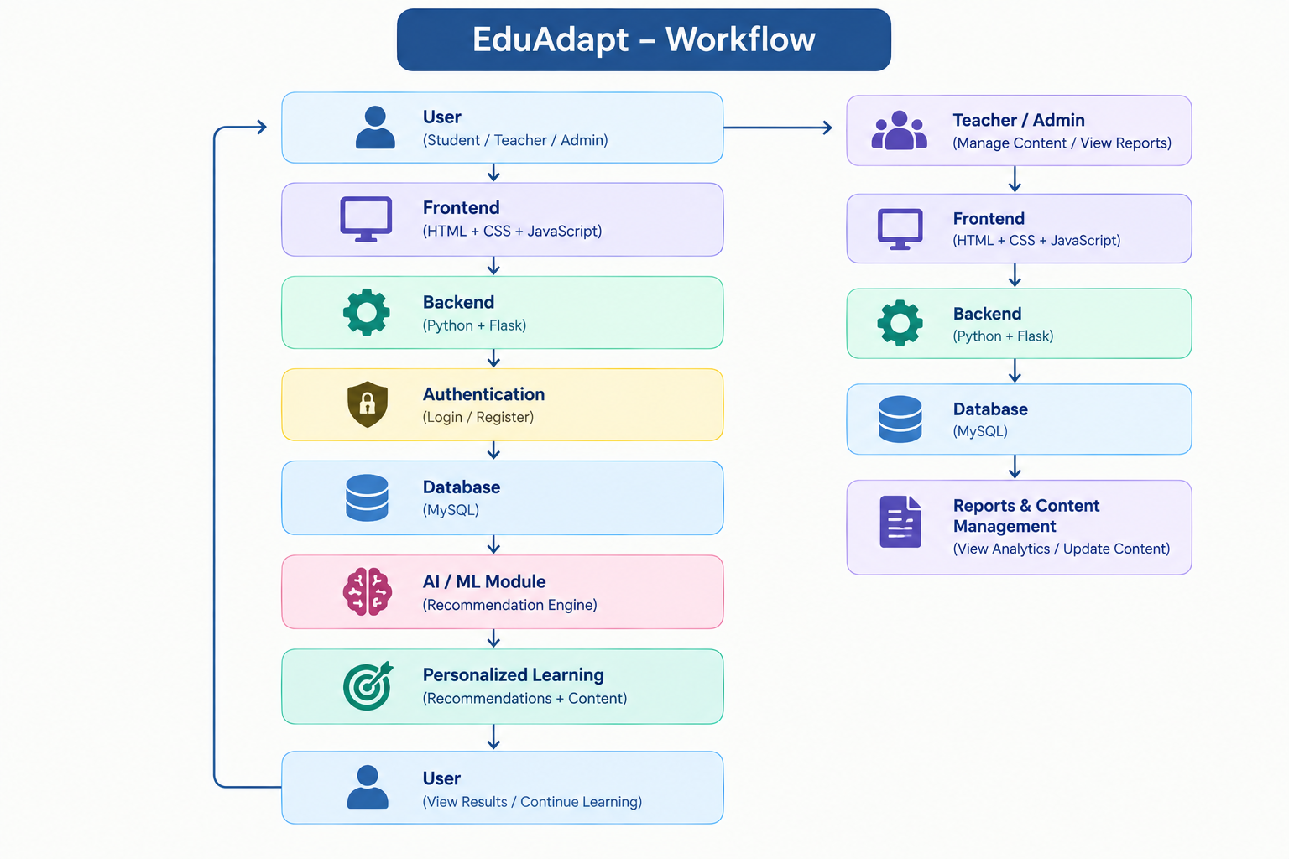
Workflow

Slide 9
Modules
Module | Main Function
User Management | Login & profiles
Course & Content | Learning materials
Quiz | Tests & scores
Performance | Analyze results
AI Recommendation | Personalized suggestions
Progress Tracking | Monitor progress
Teacher/Admin | Manage & monitor

Slide 10
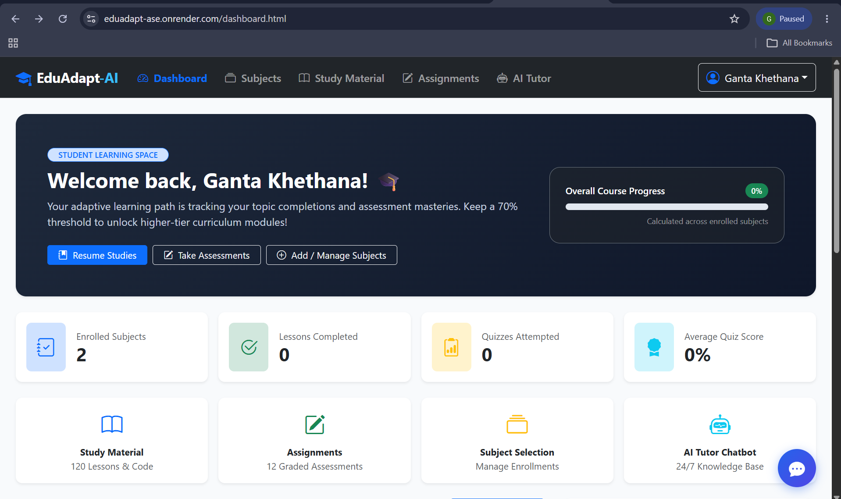
Implementation

Slide 11
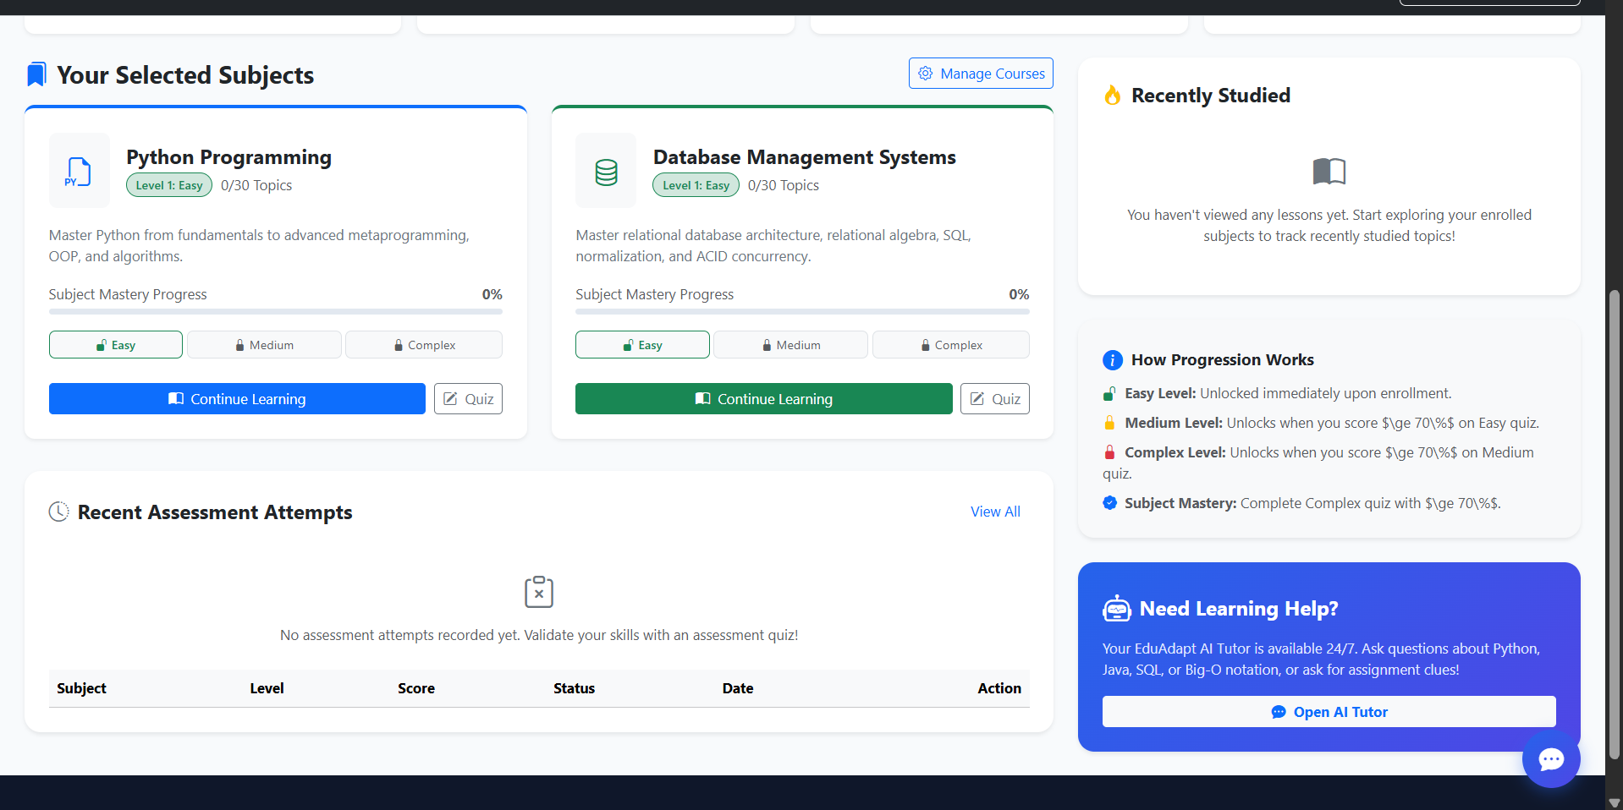

Slide 12
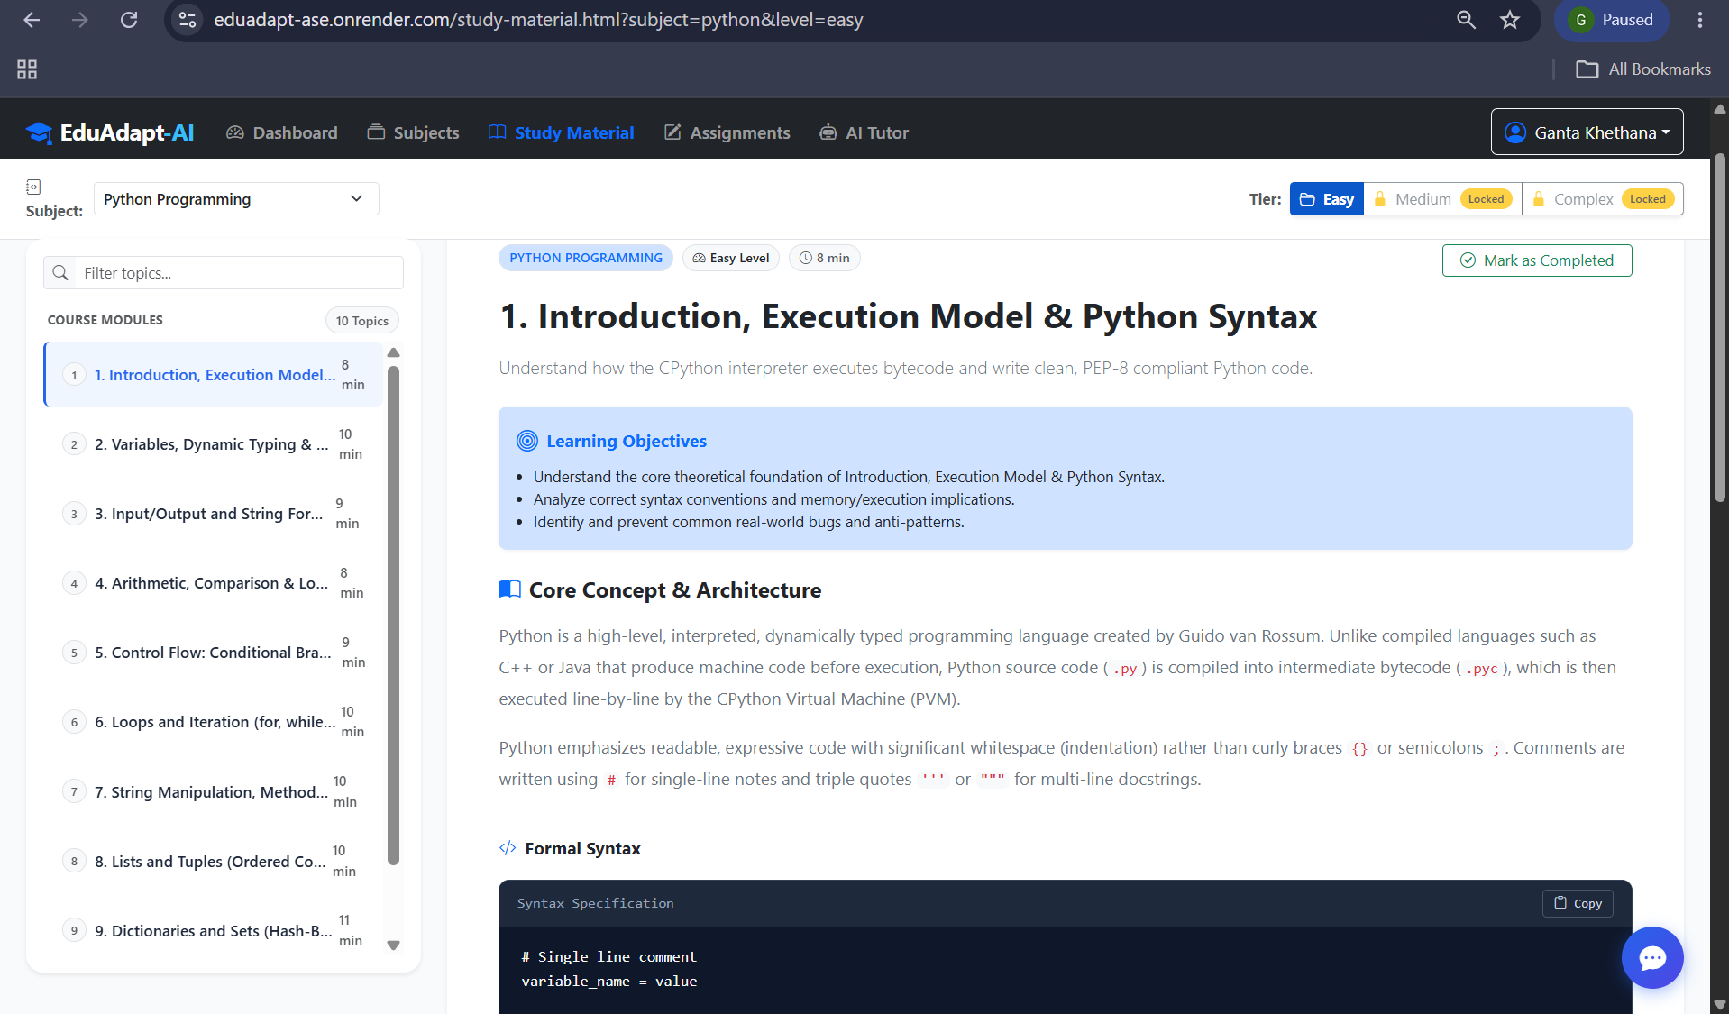

Slide 13
Conclusion & Future Scope
Conclusion
EduAdapt is an AI-powered platform for personalized learning.
It addresses the limitations of fixed and one-size-fits-all learning.
The system analyzes student performance and learning progress.
It identifies strong and weak learning areas.
Based on performance, it can provide personalized content and recommendations.
The platform includes modules for students, courses, quizzes, performance, and progress tracking.
GitHub is used for version control and team collaboration.
Future scope
Advanced AI Recommendations
  Improve recommendations using more student activity data.
Adaptive Quiz Difficulty
  Automatically adjust question difficulty based on performance.
Personalized Learning Paths
  Generate an individual sequence of topics for each student.
Advanced Analytics
  Provide detailed student performance reports and dashboards.
Performance Prediction
  Predict future performance and identify students who may need additional support.
Teacher Dashboard
  Help teachers monitor individual and class-level progress.
Mobile Application
  Make EduAdapt accessible through mobile devices.
Cloud Deployment
  Deploy the platform online for wider accessibility.

